Slide 1
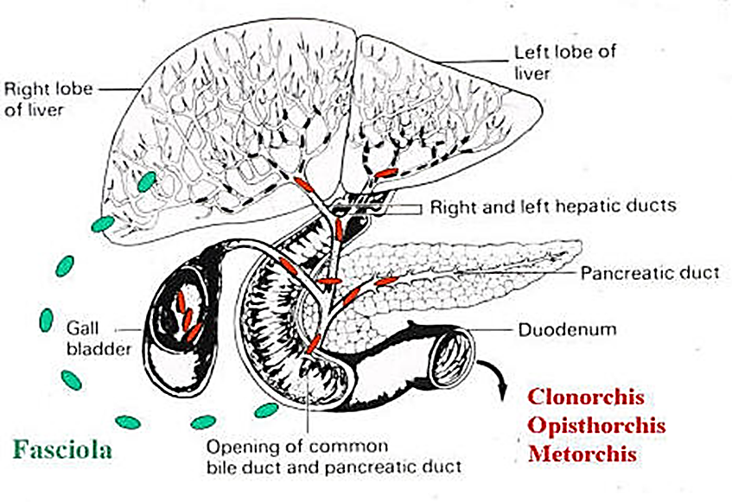

Liver Flukes

Slide 2
1- Family: Fasciolidae: Fasciola hepatica, Fasciola gigentica
Phylum: Platyhelminthes
Class: Trematodes
Subclass: Digenea
Order: Echinostomatiformes
Family: Fasciolidae
Genus: Fasciola hepatica, Fasciola gigantica
large, leaf-shaped, with cephalic cone
mainly in herbivores
intestinal cecae, testes, and ovary dendritic
The disease cause Fascioliasis
Intermediate host: fresh water snails
Final host: Cattle
Site of Infection: hepatic and portal vessels

Slide 3
life-cycle
Adults in gall bladder, bile ducts, eggs out with feces, unembryonated, develop in 9-10 days, hatch to miricidia and penetrate several species of snails. Sporocyst; two redial generations, cercaria emerge 5-7 wk post-infection, encyst as metacercariae on underwater vegetation, ingested; cross gut and penetrate liver (glycocholic acid in bile the stimulus; migration cue), feed in liver for 2 months, then enter bile ducts and after another month, mature and produce eggs.

Slide 4
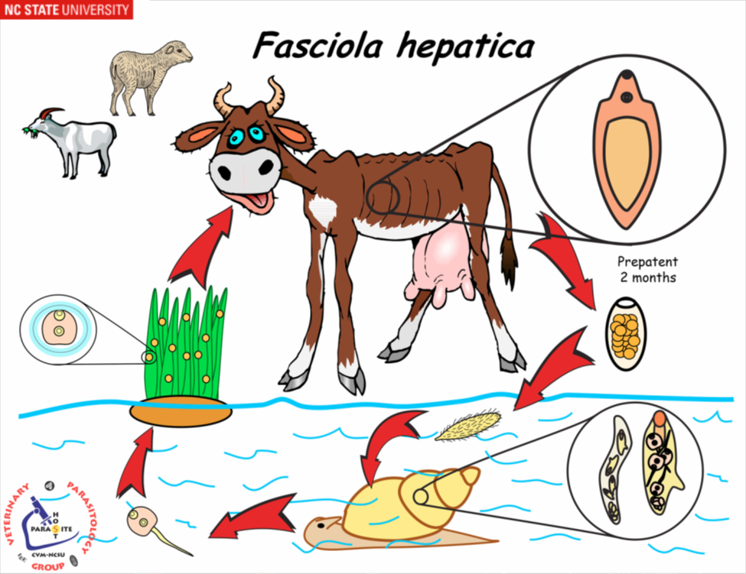


Slide 5
Pathology
inflammation and erosion of bile ducts
tissue destruction of liver
fibrosis of liver and bile duct walls
back pressure in liver, leading to cirrhosis and jaundice
blockage of bile ducts
abscesses in liver
migrating juveniles may cause ectopic abscesses in lungs, brain, skin, eye.
halzoun - adults attach in nasopharynx after eating raw liver (middle east)

Slide 6
Symptoms:
Acute
More common in sheep
10,000+ Metacercariea consumed at one time
Dramatic Liver Inflammation, Frequently Resulting in Death
Chronic
More Common and Rarely Fatal
Nonspecific Symptoms
Halzoun
Eating raw, infected liver
Infects pharynx
Causes swelling and obstructs breathing

Slide 7
Related species
Fasciola gigantica(found in a variety of Artiodactylids in Africa, India, portions of Europe, Indonesia, Asia, and Hawaii. The most common infections occur in cattle, sheep, and goats. Patent infections in humans also occur). Hybrids between this species and Fasciola hepatica have been reported.
Fasciola jacksoni(nasty pathology in Asian elephants)
Fasciolopsis buski(swine and humans in Asia).

Slide 8
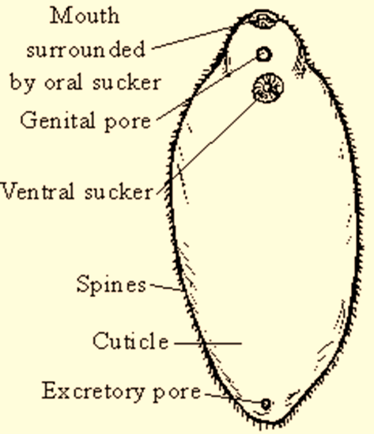
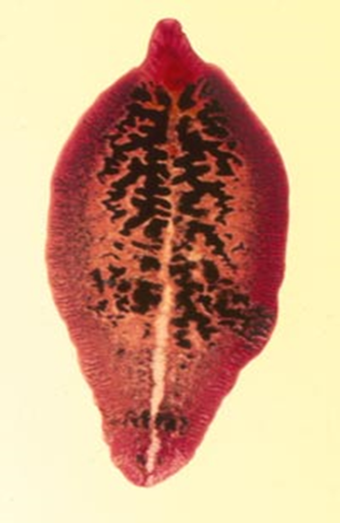


Slide 9
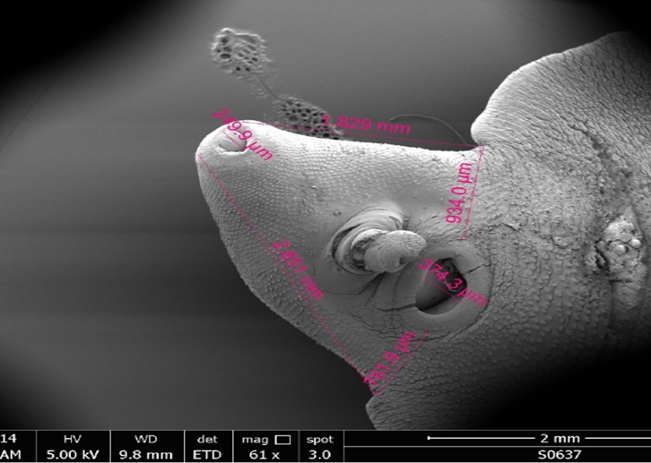
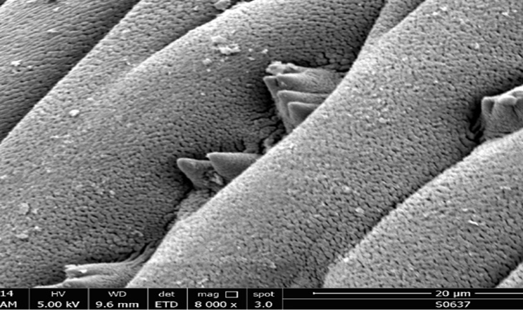
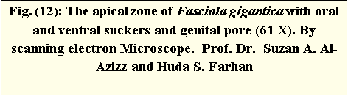
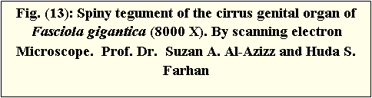

Slide 10
Treatment:
Bithional
Highly Effective
Large Dose
High Cost
Long Treatment Period
Triclabendazole
Easier to Use
1-2 Oral Doses in 24 hrs
Virtually 100% Effective
Surgery

Slide 11
THANK YOU

